Slide 1


Angular
Aruna S
Department of
Computer Science and Engineering

Slide 2

angular
Services and Dependency Injection
S. Aruna
Department of Computer Science and Engineering

Slide 3
Angular
Angular Services
Service is a piece of reusable code with a focused purpose. A code that you will use it in many components across your application.
An Angular service is simply a Javascript function. All we need to do is to create a class and add methods & properties. We can then create an instance of this class in our component and call its methods.
One of the best uses of services is to get the data from the data source.

Slide 4
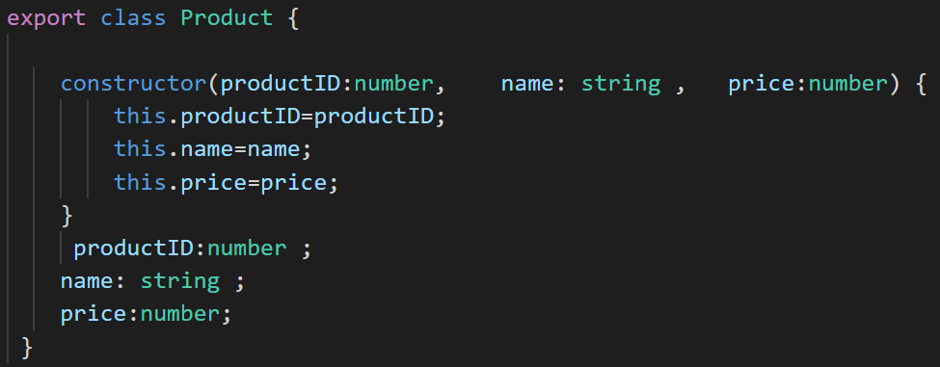
Angular
Angular Services
The Product class is the domain model.

Slide 5
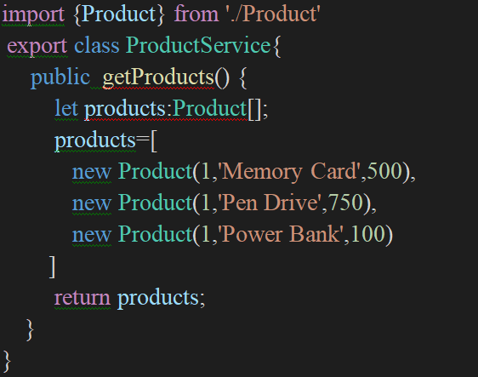
Angular
Angular Services – An example
A service which returns the list of products.

Slide 6
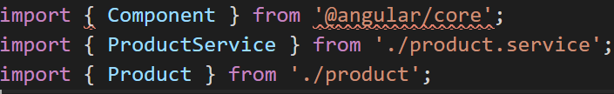
Angular
Angular Services – An example
.
Invoke the ProductService from the component.

Slide 7
Angular
Angular Dependency Injection Framework
Angular Dependency Injection framework implements the Dependency injection Pattern in Angular. It creates & maintains the Dependencies and injects them into the Components or Services which requests for it.
There are five main parts of the Angular Dependency injection Framework.
Consumer
The Component that needs the Dependency. In the above example, the AppComponent
is the Consumer
Dependency
The Service that is being injected. In the above example the ProductService is the Dependency
.

Slide 8
Angular
Angular Dependency Injection
DI Token
The DI Token uniquely identifies a Dependency. We use DI Token when we register dependency
Provider
The Providers Maintains the list of Dependencies along with their Tokens. The DI Token is used to identify the Dependency.
Injector
Injector holds the Providers and is responsible for resolving the dependencies and injecting the instance of the Dependency to the Consumer
.

Slide 9
Angular
How Angular Dependency Injection works?
The dependencies are registered with the Provider. This is done in the Providers metadata of the Injector.
Angular provides an instance of Injector & Provider to every Consumer.
Consumer when instantiated, It declares the Dependencies it needs in its constructor.
Injector reads the Dependencies from the constructor of the Consumer and looks for the dependency in the provider.
The Provider provides the instance and injector, then injects it into the consumer.
If the instance of the Dependency is already exists, then it is reused making the dependency singleton.
.

Slide 10
Angular
Angular Services – An example
.
The productService is instantiated in the Component directly as shown below
Directly instantiating the service, as shown above, has many disadvantages
The ProductService is tightly coupled to the Component.
If we change the ProductService class definition, then we need to update every code
where service is used
If we want to change ProductService with BetterProductService,
then we need to search wherever the ProductService is used and manually change it
makes Testing difficult.
This problem can be solved by Angular Dependency Injection.

Slide 11
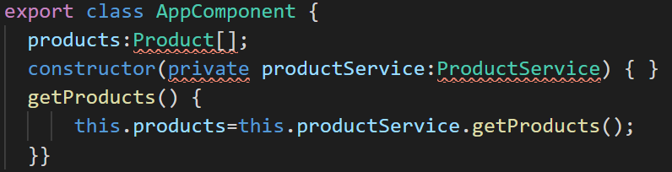
Angular
Angular Dependency Injection
Dependency Injection (DI) is a technique in which we provide an instance of an object
to another object, which depends on it.
This is technique is also known as “Inversion of Control” (IoC).
Move the creation of ProductService to the constructor the AppComponent class as shown below.
.
AppComponent does not create the instance of the ProductService. It just asks for it in its Constructor.
The AppComponent is now decoupled from the ProductService.
The AppComponent does not know anything about the ProductService. It just works with the ProductService passed onto it. providers: [ProductService]

Slide 12
THANK YOU
Aruna S
Department of
Computer Science and Engineering
arunas@pes.edu

